Slide 1
Guidelines & Principles (plus an example of theory)
CZ2004 HCI
Nanyang Technological University

Slide 2
“Guidelines, Principles, and Theories”
Reading - Textbook
Chapter 2.1, 2.2, 2.3, 2.4.2
If you are still interested, self-learn other parts in 2.4
Goal:
Introduce you to the study and practice of HCI
Overview
Guidelines – narrowly focused rules
Principles – widely applicable and enduring
Theories – tested, proven, broadly useful

Slide 3
Introduction
Guidelines
Principles
Theories
High-level theories that describes objects and actions with consistent terminology to support communication & teaching. Can be used to predict performance, errors, understanding, satisfaction of user.
Middle-level practices that can be applied to different guidelines, analyzing and comparing design alternative.
User classification, “8 golden rules of UI design”, etc.
Design-level practices and rules that make for good and consistent design (some based on theory).
Examples: Apples guidelines on for UIs

Slide 4
Why guidelines, principles and theories?
Why have guidelines, principles, and theories?
Help keep our UI designs be focused and consistent.
Help avoid and remedy mistakes (e.g., cluttered display, tedious procedures, inadequate functionalities, etc.)
Provide theories and high-level descriptions of interaction and design
The role of theory in this course
We will not spend a lot of time on any specific theory
However, it is important to understand the role of theory, and its relationship between guidelines and principles
We will only carefully study one example of the theories – the stage of actions

Slide 5
Guidelines
Definition
Components
Important (example) guidelines
Navigation
Helping people with disability
Display organization
Data entry

Slide 6


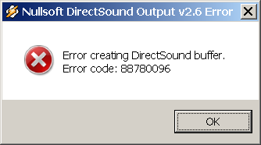
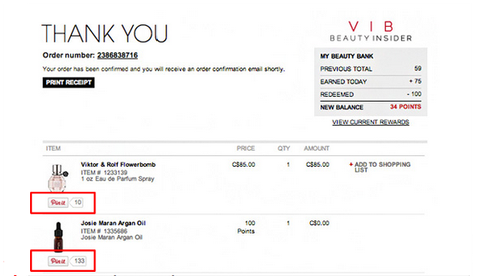
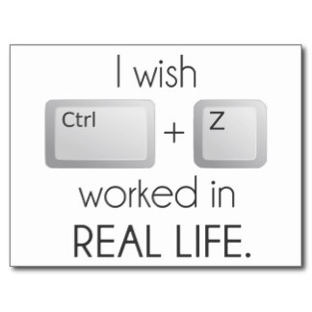
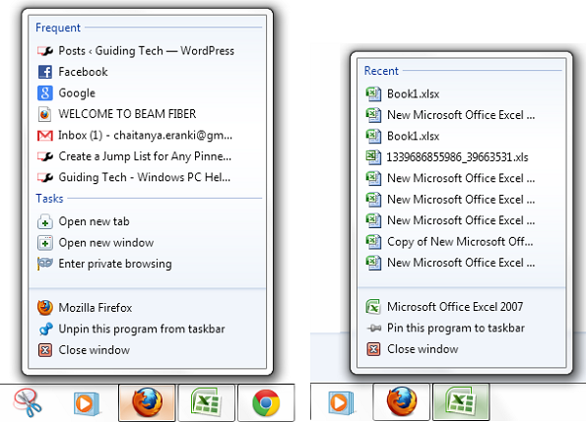

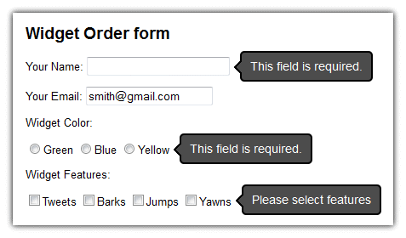
Recap: 8 golden rules of interface design
Strive for consistency
Cater to universal usability (e.g., through personalization)
Offer informative feedback
Design dialogs to yield closure
Permit easy reversal of actions
Support internal locus of control
Reduce short term memory (e.g., “Based on your answer to question 27 two pages back …”).
Prevent errors

Slide 7
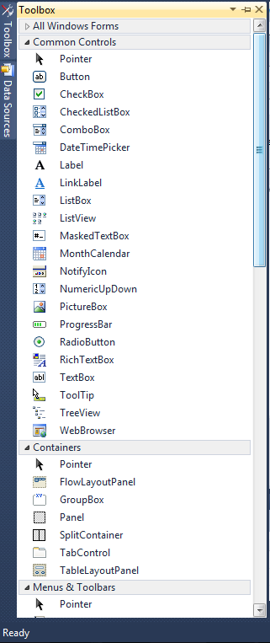
What are “guidelines”?
Guidelines were developed in the “early days”
Best Practices
For example, Windows and Apple UI
From experience
For example, of Microsoft or Apple interface designers
Good starting point for all projects involving a UI
Developed “Shared language”
Widget Names, Functionality name, etc
Gives all developers involved a language to discuss the UI

Slide 8
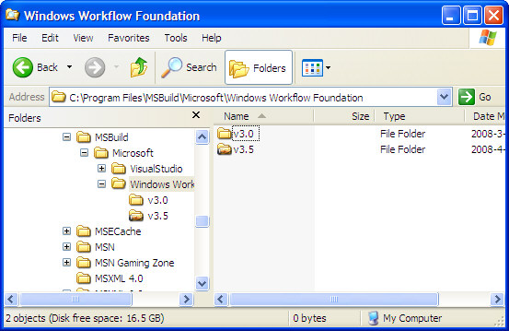
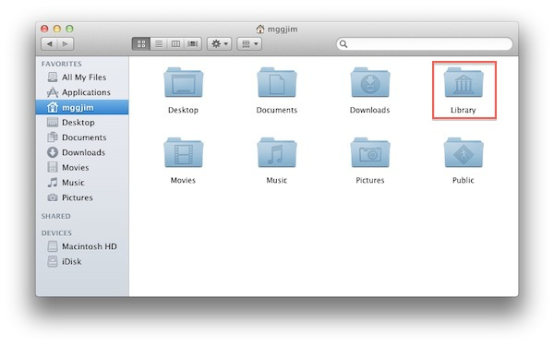
Components that form guidelines
(1) Rules (Specific and practical )
Provide cures for design problems
Provide cautions for potential dangers
Reminders based on experience
(2) Examples
Give details on how a design must be performed
Style, color usage, window appearance, etc
Interaction usage (when to use check-boxes,
when to user buttons, etc)
These guidelines could be based on experience
Ex: developers found that users preferred a list+slider over a pull-down menu for a long list of choices
Require all developers to follow the guidelines

Slide 9
Components (cont.)
(3) Document
Any serious large-scale UI design should have a “Guideline Document”
Provides a “Shared language” that developers and customers can use
Allows consistency within a design team
Especially a large-team working on a large project
Guidelines document is not trivial
Think of the effort needed to specify “everything” pertaining to the UI, but it is necessary

Slide 10
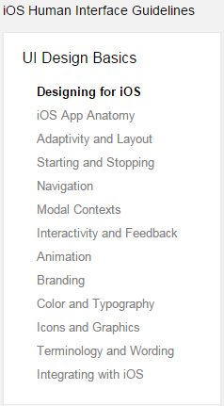
(Guideline) Document
Can be used to specify many aspects of an interface:
Input and output formats
Action sequences
Terminology
Hardware devices/platforms
Provide Examples & counterexamples
Pros:
Builds upon (good previous) experience
Continued improvements
Cons:
Too specific
Hard to innovate
Not applicable/realistic to the situation
Hard to apply
What do you do when having an exception?

Slide 11
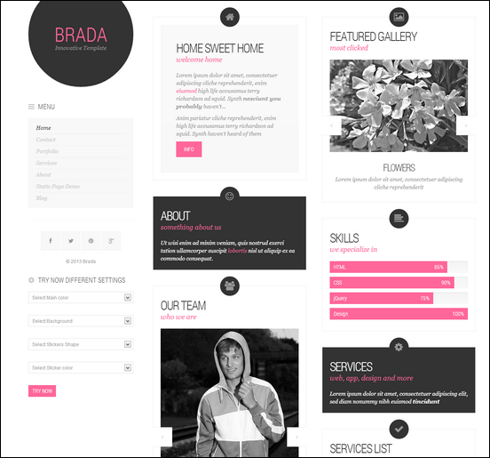
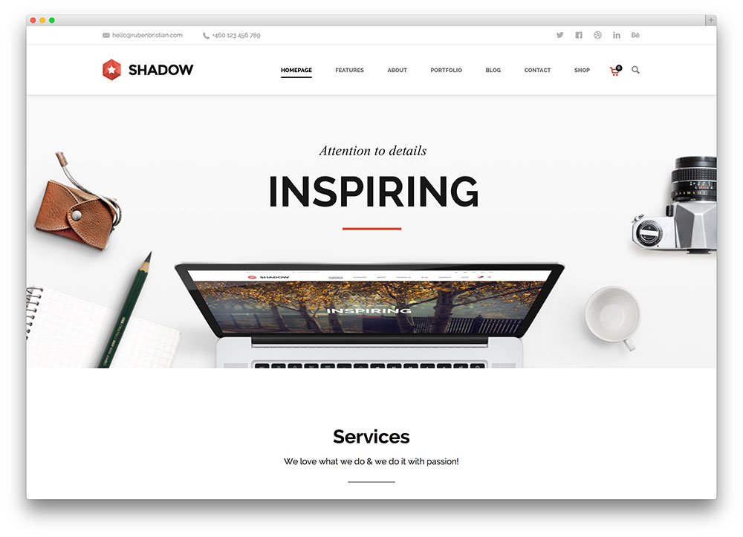
Guideline Document: Example
Think about templates
Word
PowerPoint
LaTeX
Any other from you?

Slide 12
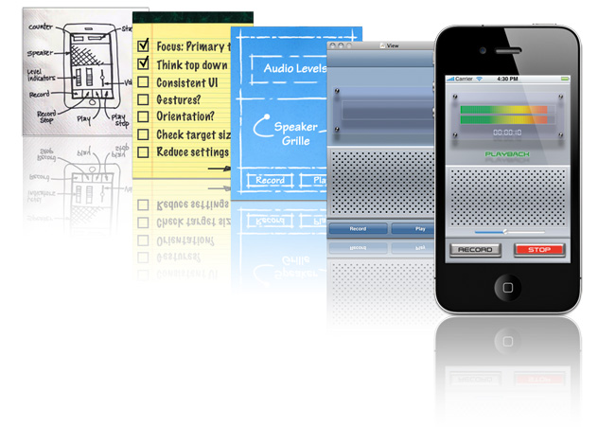
#1: A case study: iOS 7 guideline
Apple’s “Design Principles” http://developer.apple.com/library/ios/#documentation/UserExperience/Conceptual/MobileHIG/Principles/Principles.html#//apple_ref/doc/uid/TP40006556-CH5-SW1
Apple’s “Human Interface Guidleine for iOS 7”
https://developer.apple.com/library/ios/documentation/UserExperience/Conceptual/MobileHIG/index.html#//apple_ref/doc/uid/TP40006556

Slide 13
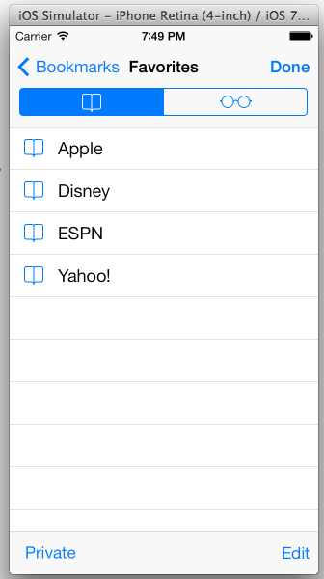

iOS 7: Navigation Bar (from Apple library)
Definition
A navigation bar enables navigation through an information hierarchy and, optionally, management of screen contents
Example
Rules
A navigation bar is translucent.
Generally appears at the top of an app screen, just below the status bar. On iPad, a navigation bar can also display within a view that doesn’t extend across the screen, such as one pane of a split view controller.
Can automatically change its height when an iPhone changes orientation. Maintains the same height in all orientations on iPad
From: iOS UI Element Usage Guidelines
https://developer.apple.com/library/ios/documentation/UserExperience/Conceptual/MobileHIG/Bars.html#//apple_ref/doc/uid/TP40006556-CH12-SW1

Slide 14

iOS 7: Navigation Bar (cont.)
Selected guidelines
(Only portions of those listed by Apple)
When it adds value, use the title of the current view as the title of the navigation bar
Consider putting a segmented control in a navigation bar at the top level of an app
Avoid crowding a navigation bar with additional controls, even if it looks like there’s enough space
Make sure text-titled buttons have enough space between them
Don’t create a multisegment back button
Counterexample
Why is it bad?
Example iOS Navigation Guideline Videos

Slide 15
#2: Navigating the Interface
Example from National Cancer Institute (NCI)
Developers developed 388 guidelines backed by research for designing their web-pages
Some guidelines established by the NCI website developers
Standardize task sequences
Ensure that embedded links are descriptive
Use unique and descriptive headings (related to the content they describe)
Use check boxes for binary choices
Develop pages that will print properly
All pages/information on the web should be printable
Use thumbnail images to preview larger images
Go to their website, http://www.nci.nih.gov/ and evaluate:
Pretend to be different types of User: Novice, Intermediate, Expert
Test Different Tasks: Education, Search, Research
Are the pages consistent? Are the guidelines followed?

Slide 16
#3: Guidelines for Disabled
WWW Consortium adopted these guidelines for designing web pages for the disabled
Text equivalent for every non-text element (images, image map, animations, applets, ascii art, frames, scripts, bullets, sounds, audio, video, etc.)
Any time-based multimedia, provide equivalent synchronized alternatives (captions, descriptions, subtitles)
All color info can be captured by users without color – from context or markup
Title each frame, facilitating frame identification and navigation
Enables screen readers or other technologies to have multiple methods to obtain the webpage info
How does this end up helping everyone?

Slide 17
#3: Display organization guidelines
Consistency of data display
Terminology, abbrev., formats, colors, grammar, capitalization should be consistent!
Efficient information assimilation by the user
Familiar format
Related to tasks at hand
e.g. spacing, formatting, labels, units/measurements, numbers of decimal points
Minimal memory load on the user
Minimal carry information over from on screen to another
Require fewer actions
TAB key to move to next entry field vs. having to use the mouse
Labels and common formats should be provided for novice (Ex. SSN/phone #)

Slide 18
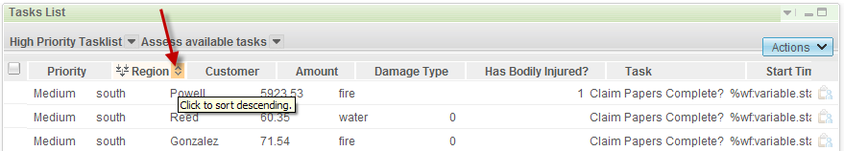
Display organization guidelines (cont.)
Compatibility of data display with data entry
Entering data should look similar to the eventual viewing of the data
Flexibility for user control of data display
User control for information display (e.g., sorting, ordering of columns and rows)
Only a starting point
Has many special cases
Application specific, hardware independent (e.g., ATMs)

Slide 19
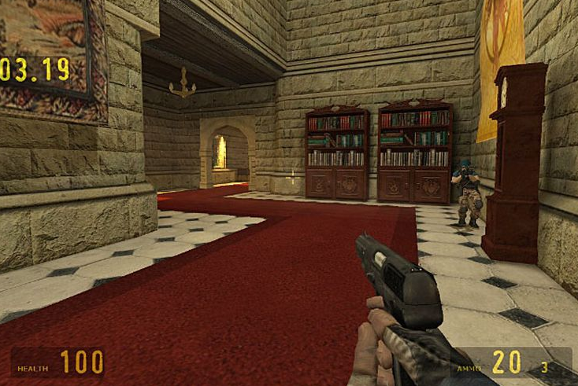
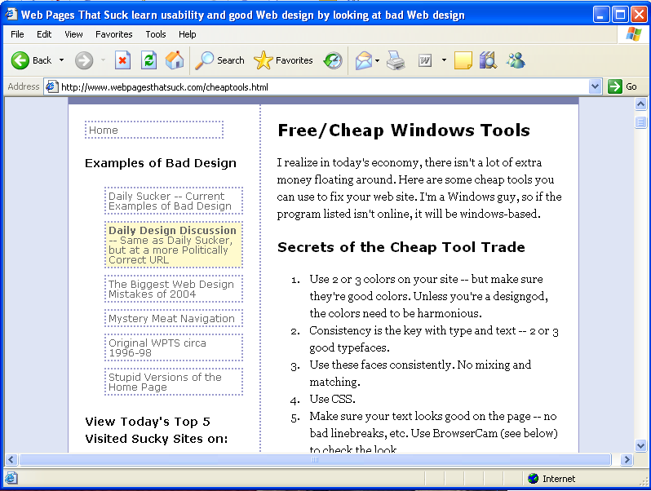
#4: Displays vs. User’s attention!
User sees lots of data in front of them
Urgent, exceptional, and time-dependent conditions need to be brought forward
Ex. games and damage (visual, audio)
Intensity – two levels only, limited use of high intensity
Marking – underlines, enclose it in a box, arrows, asterisk, bullet, dash
Size – Up to 4 sizes, with larger sizes attracting more attention
Fonts – three fonts

Slide 20
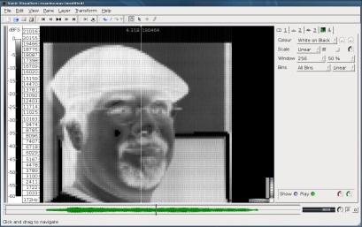

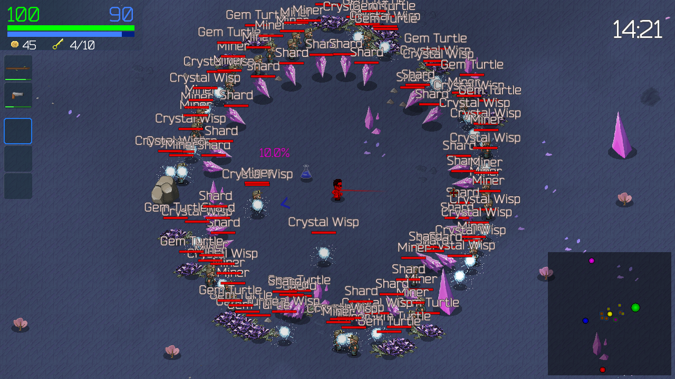
Displays vs. User’s attention! (cont.)
Inverse video – inverse coloring
Blinking Colors
Should blink at 2-4 blinks per second (Hz), Color – no more than 4 on a screen
Audio
soft tones – positive
harsh – emergency
multiple levels are difficult to distinguish, do we like human voices?
Danger in overusing the above
Animation should provide needed information (e.g. progress indicator)
Similarly highlighted items imply relationships
Novices need simple, logically organized, well labeled displays
Experts want shorter labels, more flexibility, subtle highlight of changed values

Slide 21
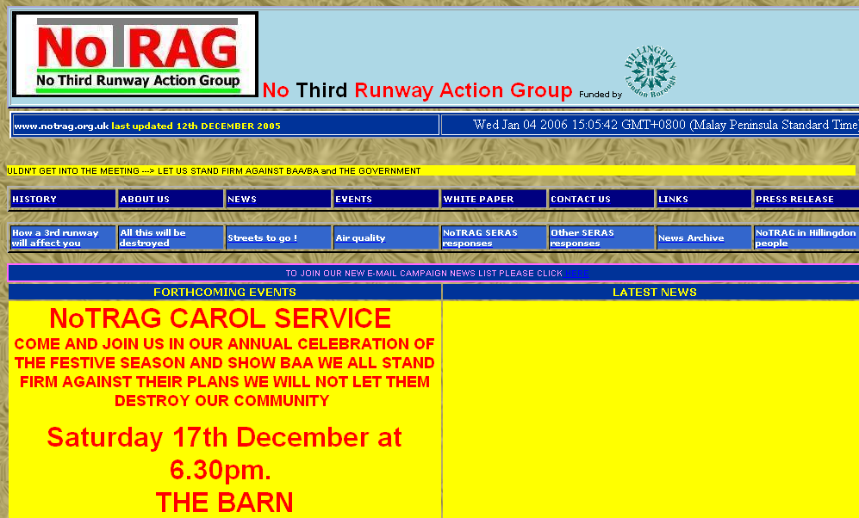
Example of a Bad Webpage
This part blinks.
Compare with the current version: http://www.notrag.org.uk/
(still available in early 2014, but just before our class, it is not accessible -> check web archive)
From: http://www.webpagesthatsuck.com

Slide 22
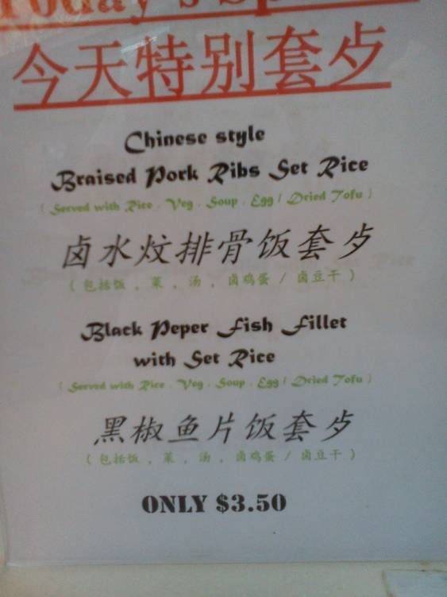
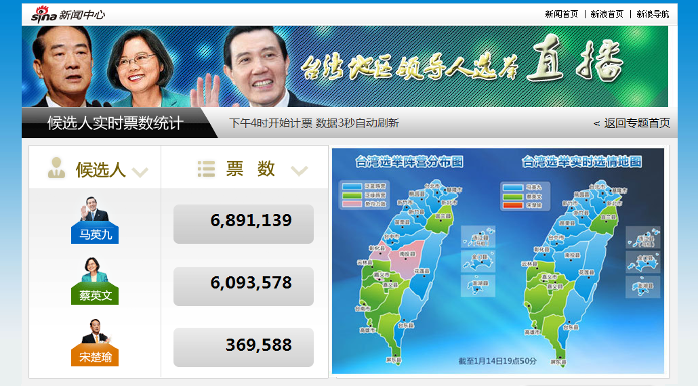
A case study: good vs. bad attention

Slide 23
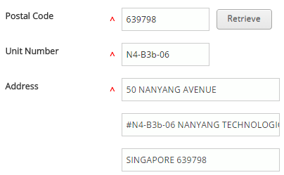
#5: Data Entry guidelines
Data entry can occupy a substantial portion of user’s time and be the source of frustrating and potentially dangerous errors
Consistency of data-entry transactions – similar sequence of actions, delimiters, abbrev.
Minimal input actions by user
fewer actions = greater productivity and less error
E.g., single key-stroke vs. mouse selection, vs. typing is typically better
E.g., Command line vs. GUI
Too much hand movement is not good. Ex. Experts prefer to type 6-8 characters instead of moving a mouse, joystick, etc.
Avoid redundant data entry (waste of time, perceived effort, increased error). System should aid but allow overriding

Slide 24
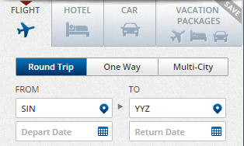
Data Entry guidelines (cont.)
Minimal memory load
Don’t use codes, complex syntactic strings
E.g., Don’t user codes for a country on a web form
Provide “selection” from a list
don’t need to memorize choices
Compatibility of data entry with data display
should match display capability
Flexibility for user control – Experienced vs. novice
Experienced may want “hot-keys”, novice doesn’t
All you Ctrl-F file people are happy!
Should be used cautiously, since it goes against consistency

Slide 25
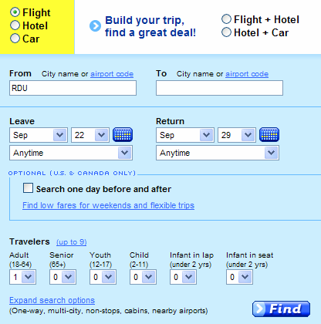
A case study: booking flights
han.yu@ntu.edu.sg

Slide 26
Principles
More fundamental, widely applicable, and enduring than guidelines
Fundamental principles for all UI
Determine user’s skill levels / Spiral design strategy
Identify the tasks of the application
Five primary interaction styles
Eight golden rules of interface design
Prevention of errors

Slide 27
Determine user’s skill levels
“Know thy user” Hansen (1971)
First principle in Hansen’s classic list of user-engineering principles.
Simple idea, but a difficult and unfortunately often undervalued goal.
Start with population profile:
Age, gender, physical and cognitive abilities, education, cultural or ethnic background, training, motivation, goals and personality
Design goals based on skill level
Novice or first-time users
Knowledgeable intermittent users
Expert frequent users

Slide 28
Novice/First-Time Users
What would you need to consider for:
Grand-parents sending first email
Airport check-in kiosks
Inexperience with interface (e.g., first time professionals)
Anxiety
Solutions
Restrict vocabulary
Providing help: Instructions, dialog boxes, know who to turn to for help, multiple languages, consistent terms
Small number of actions
Feedback
Good Error messages
Documents: Video demonstrations, online tutorials, good manuals

Slide 29
Knowledge-able Intermittent Users
E.g., Frequent travelers, managers and code/word processors.
These users understand task concepts, and interface basics
May have difficulty retaining the structure of menus, or the location of features
Solutions:
Consistent sequences of actions
Meaningful feedback
Guides to frequent patterns of usage
Protection from danger (encourage exploration), e.g., undo
Context dependent help

Slide 30
Expert/Frequent Users
Thoroughly familiar with task and interface
Goal is efficiency (high speed, low error)
Solutions:
Rapid response time
Brief feedback
Shortcuts
Macros, abbreviations and other accelerator

Slide 31
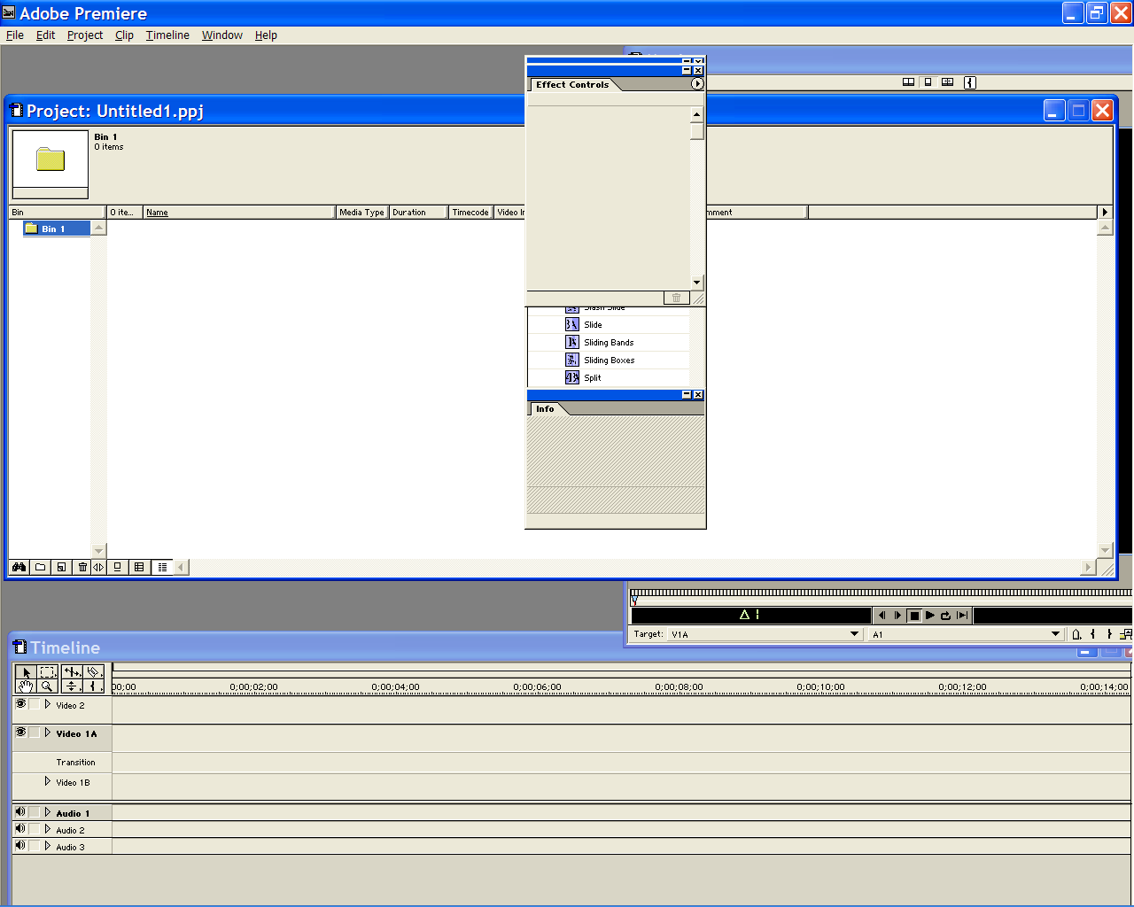
Multi-layer strategy
You might be designing for more than one of these classes
Approach is typically a multi-layer (a.k.a. level-structured or spiral)
Novices use a subset of commands, actions, and objects
Can move up when they feel comfortable
Ex. Cellphones
Novices: phone calls easy to make
Experts: store #s, web, game,
address book
Also involves manuals, help screens, errors messages, tutorials, feedback
Different for multi-layer users

Slide 32
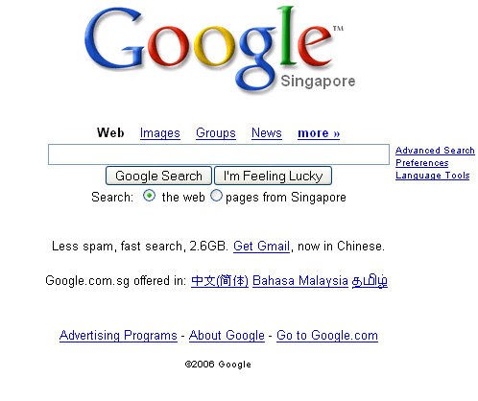
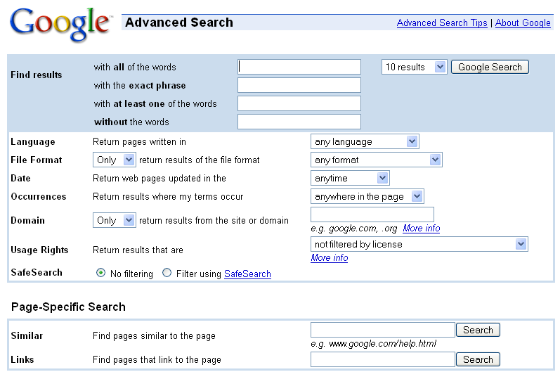
A case study: Google search & options
Expand control to accommodate different users
Easy control
Advance control

Slide 33
Identify the tasks
After carefully drawing the user profile, the developers must identify the tasks to be carried out.
Every designer would agree that the set of tasks must be determined before design can proceed, but too often the task analysis is done informally or implicitly.
Task Analysis usually involve long hours observing and interviewing users
Decomposition of high level tasks
Relative task frequencies

Slide 34
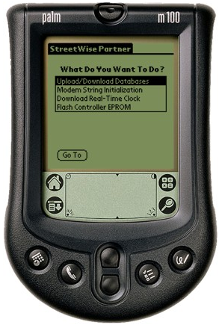
Identify the Tasks
How?
Brainstorm
Observe and interview users (esp. newer versions)
Example: Palm Pilot
Limited functionality = universal usability
Successful because of ruthlessly limiting functionality (calendar, to-do list, contacts and notes) to guarantee simplicity
“Atomicity” of tasks is important to consider
Too small = too many steps (inefficient, frustrating)
Too many = need special cases, inflexible, frustrating
Task frequency
High frequency = simple, quick, even if it slows other tasks down
Task vs. Job Frequency Matrix (see next slide)
Task analysis and task objects and objects defined

Slide 35
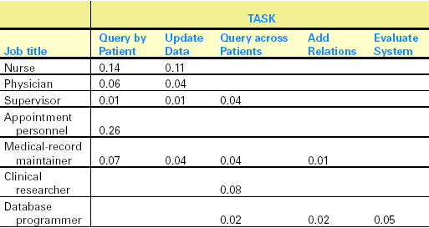
A case study: Hospital information system
User-needs assessment clarifies what tasks are essential for the design and which ones could be left out to preserve system simplicity and ease of learning
Should be starting point for any good UI designer

Slide 36
Choose Interaction Style
Five main types of interaction style
Direct Manipulation
Menu Selection
Form-fill in
Command Language
Natural Language

Slide 37


1. Direct manipulation
Manipulate visual representations, e.g. Desktop metaphor, CAD, games
Appealing to novices and easy to remember for intermittent users.
Pros: fast, feedback, easy to understand and retain (ex. icons on your desktop), exploration encouraged, good for novices, and can be good for other classes, visual data
Cons: hard to program, interaction devices are harder to design or modify

Slide 38
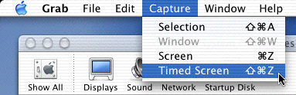
2. (Menu) Selection
User reads a list of items, and selects one
Appropriate for novice and intermittent users and can be appealing to frequent users if the display and selection mechanisms are rapid.
Pros: no memorization, few actions, clear structure, tools for validity and consistency exist
Cons: Make actions understandable not easy, careful task analysis

Slide 39
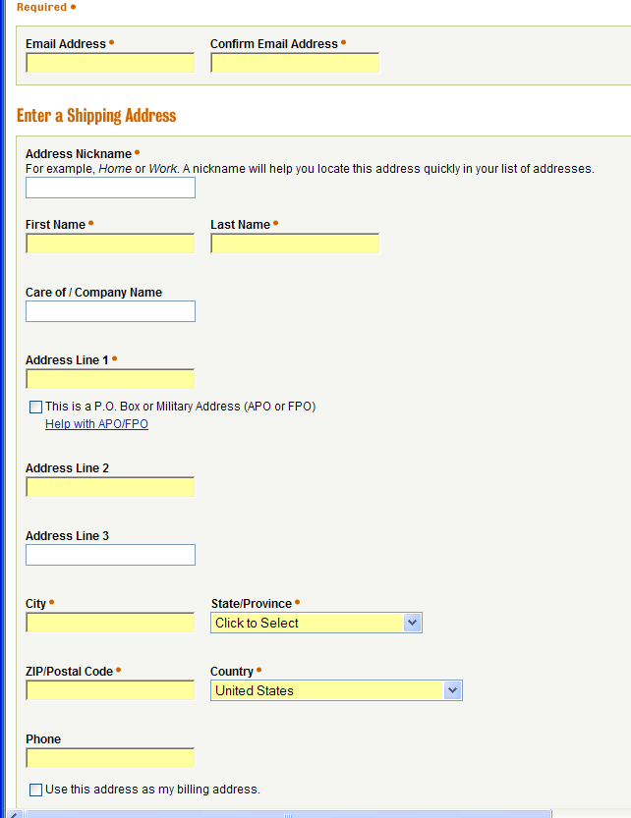
3. Form fill-in
Data entry into fields
Most appropriate for knowledgeable intermittent users or frequent users.
Pros: rapid, for more advanced users, tools available for forms
Cons: must understand labels and request format, be able to respond to errors, training required

Slide 40
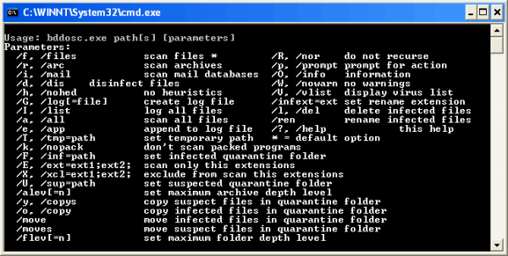
4. Command language
Suitable for expert frequent users who derive great satisfaction from mastering a complex set of semantics and syntax.
Pros: feeling of control, most advanced users like it, rapid, histories and macros are easy, flexibility
Cons: high error rates, training required, poor retention rate, hard to create error messages

Slide 41


5. Natural language
Computers will respond properly to arbitrary natural language sentences or phrases.
Pros: easy to learn
Cons: unpredictable, requires clarification dialog, technology is not fully developed . . Still in research stage.
\
NL is the Ultimate Goal
Was “science fiction”, Example: HAL9000
Is Siri or other similar natural language service ready now?
http://www.kubrick2001.com/
HAL9000 Computer (From 2001)

Slide 42
8 golden rules of interface design
Strive for consistency
Cater to universal usability
Offer informative feedback
Design dialogs to yield closure
Permit easy reversal of actions
Support internal locus of control
Reduce short term memory
Prevent errors

Slide 43
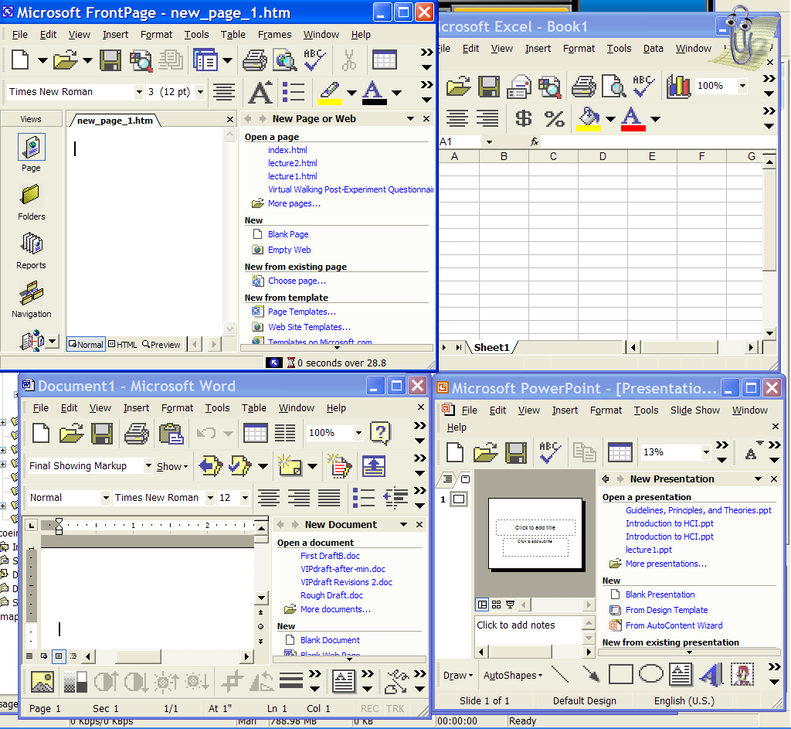
1. Strive for Consistency
Consistent sequence of actions for similar situations
Identical Terminology (prompts, menus, help)
Consistent visual layout (fonts, color, etc.)
Exceptions:
Confirmation of deletion
No password echoing

Slide 44
2. Cater to Universal Usability
Recognize the needs of a diverse user group
Design for plasticity (transformation of content)
Plasticity means content can be used on any type of display
Interface supports Novice -> Expert
Usable by Disabled
http://www.cnn.com (web and mobile version)

Slide 45
3. Offer Informative Feedback
For every user action, system should provide feedback
Frequency of task affects feedback type
Common tasks – modest feedback
Errors/uncommon tasks – substantial feedback
Visual approaches make feedback easy

Slide 46
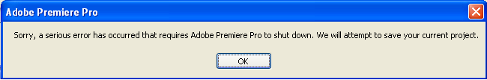
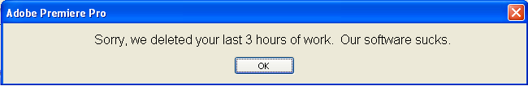
Adobe Premiere Pro 1.5 (USD$500-700)
(not more useful, but more honest)

Slide 47
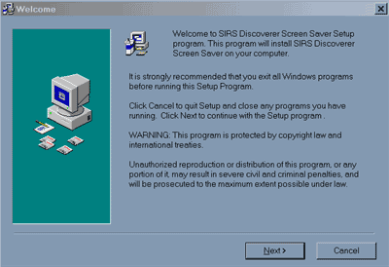
4. Design Dialogs to Yield Closure
Action sequences should have a beginning, middle, and end.
Feedback provides sense of accomplishment
E.g., Purchasing items via internet has a clearly defined step-by-step process

Slide 48
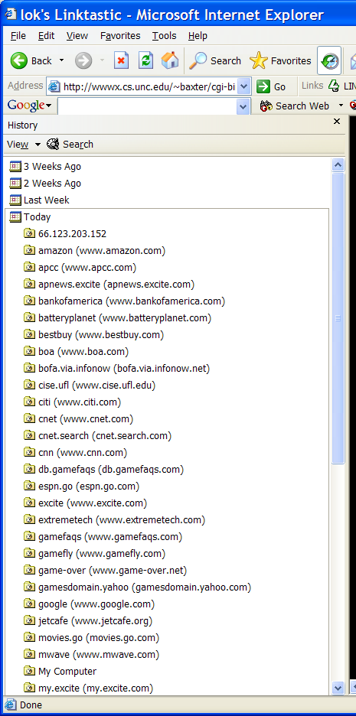
5. Permit easy reversal of actions
As much as possible, actions should be reversible
Trash can
Relieves anxiety
Design decision should include
History size
What does it mean to undo something?
Let the user know they can reverse an action

Slide 49
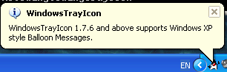
6. Support Internal Locus of Control
Experiences operators want to feel in control
User is in charge of the interface
Interface rapidly responds to the user
Builds anxiety and dissatisfaction
Surprising interface actions
Tedious actions
Difficulty in obtaining necessary ability
Difficulty in producing action
Ex. Long lag when using UI
Good rules: Avoid acausality, make users initiators rather than responders
Acausality (BAD)
Ex. some sound happens to get your attention (user not involved), little paper-clip appears when not expected
Causality (user in control) (GOOD)
Ex. Sound when clicking on a link

Slide 50
7. Reduce Short-term Memory Load
Rule of thumb: Humans can remember 7 +/- 2 chunks of information
Keep display simple
Multiple page displays should be consolidated
Training will be required if using codes, mnemonics, long sequence of actions
You should provide online access to command-syntax, abbreviations, codes, etc. (i.e., provide help)

Slide 51
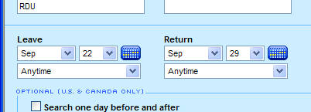
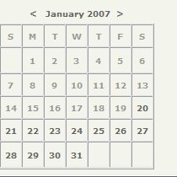
8. Prevent Errors
Limit errors a user can make
Gray out menu items that don’t apply
No characters in a numeric field
In case of errors
Detect error
Simple, constructive, and specific instructions
Do not change system state

Slide 52
8. Prevent Errors (cont.)
Error rate is typically higher than expected
What are common errors for us?
Coding, typing, dialing, grammar
How can we design software to reduce them?
Better error messages
Helps fix current error
Helps reduce similar errors
Increases satisfaction
Specific, positive, and constructive
“Printer is off, please turn on” instead of “Illegal Operation”
Reduce chance for error
Organizing info, screens, menus
Commands and menu choices should be distinctive
State of the interface should be known (change cursor when busy)
Consistency of actions (Yes/No order of buttons)

Slide 53
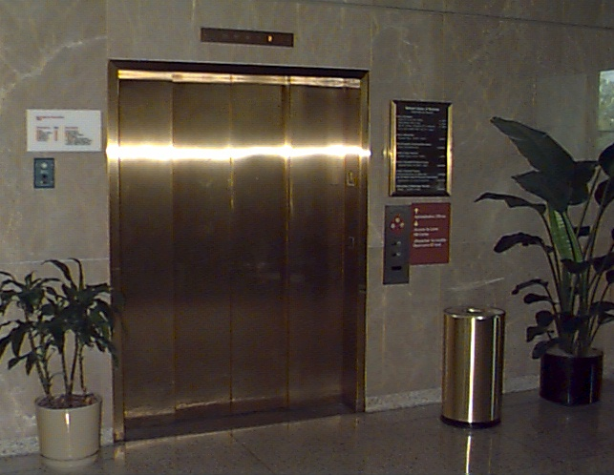

8. Prevent Errors (cont.)
Correct actions
Elevator – can’t open doors until not moving
Aircraft engines – can’t go in reverse unless landing gear is down
Choose a date from a visual calendar instead of having them type it in
Cell phones let you choose from recently dialed #s or received calls
Automatic command completion
Spell checker

Slide 54


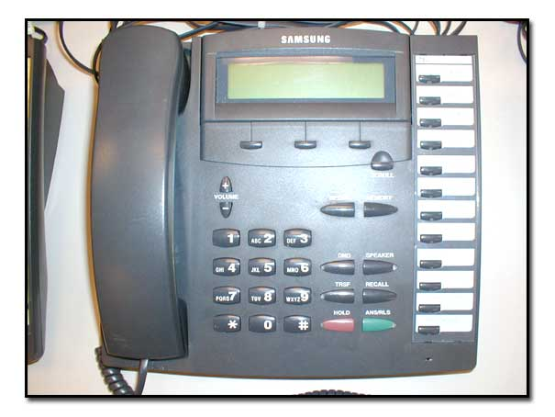
8. Prevent Errors (cont.)
Complete Sequences
One action can perform a sequence of events
E.g., Left turn signal (front and rear light flashing)
Study usage, error patterns, and user preferences via user groups, studies
Log errors
Universal Usability can help lower errors
Large buttons helps with readability, and reduces error

Slide 55
Theories
Beyond the specifics of guidelines
Principles are used to develop theories
A case study: Stages of Action

Slide 56
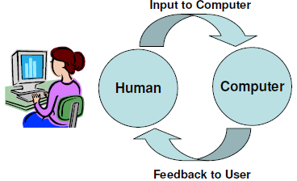
“Stages of action models”
Seven stages of action theory by Donald Norman:
Forming the goal
Forming the intention
Specifying the action
Executing the action
Perceiving the system state
Interpreting the system state
Evaluating the outcome
Norman's contributions
Context of cycles of action and evaluation.
Gulf of execution: Mismatch between the user's intentions and the allowable actions
Gulf of evaluation: Mismatch between the system's representation and the users' expectations

Slide 57
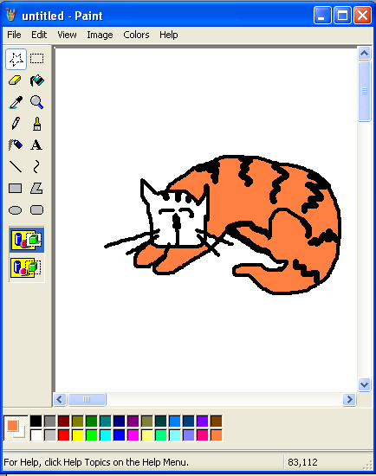
Norman’s Example
1. Forming the goal
* I want to paint the cat’s head
2. Forming the intention * I will use the paintbucket (instead of brush)
3. Specifying the action * To do this, I need to click on the
paint-bucket icon then the cat’s head region
4. Executing the action * Physically doing the action with mouse
and clicks.

Slide 58
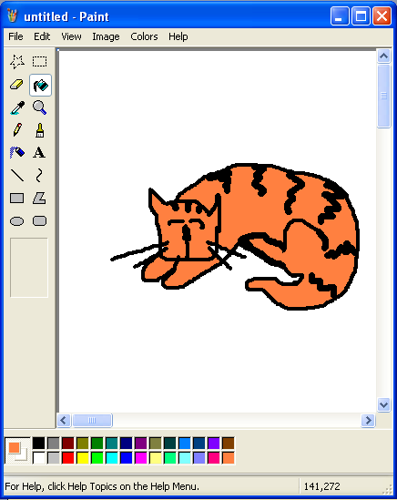
Norman’s Example
5. Perceiving the system state
* Display has changed
6. Interpreting the system state
* Cat head is orange
7. Evaluating the outcome
* Outcome is good, I’m a happy user.

Slide 59
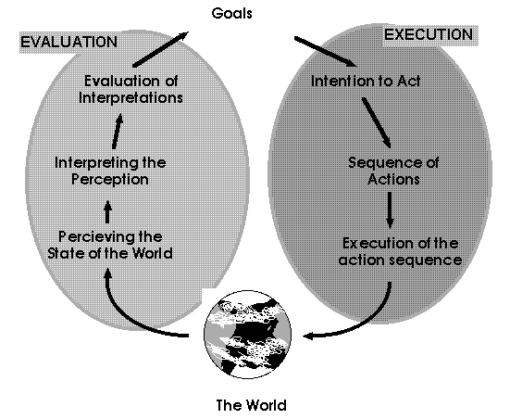
Norman’s Example
Provides a “cycle” theory of usage

Slide 60

Issues in Execution and evaluation
Gulf of execution
Mismatch between the user's intentions and the allowable actions
Gulf of evaluation
Mismatch between the system's representation and the users' expectations
Gulf of evaluation error happens here.
Could be a real error in the system, or mismatch between what the user expected.
For example, imagine you want to paint the cat’s head orange, but the program paints the entire image orange!
Gulf of execution error
happens on this side.
User wants to paint the cat’s head stripped.
There is no corresponding action to perform this.
The user is lost, confused, and makes errors.

Slide 61
Suggestions from the Theory
Four critical points where user failures can occur
Users can form an inadequate goal
Might not find the correct interface object because of an
incomprehensible label or icon
May not know how to specify or execute a desired action
May receive inappropriate or misleading feedback
To avoid “gulf” errors, the following is proposed:
Four principles of good design
Have a good conceptual model with a consistent system image
State and the action alternatives should be visible
Interface should include good mappings that reveal the relationships
between stages
User should receive continuous feedback

Slide 62
Summary
Guidelines
Narrow rules established to guide basic UI design
Principles
Widely accepted procedures and rules for UI design
Theories
High-level analysis of users to help explain reasons for designs and predict usability

